Slide 1
Software Process
Lecturer: Ngo Huy Bien
Software Engineering Department
Faculty of Information Technology
VNUHCM - University of Science
Ho Chi Minh City, Vietnam
nhbien@fit.hcmus.edu.vn

Slide 2

Objectives
To present what is a process.
To present what is a process model.
To present the elements of a process model.
To present how to use a process.
To present why use a process.
To define a process model for executing a project phase or activity.

Slide 3

References
Bill Curtis et al. (1992) Process Modeling.
Silvia T. Acuna and Xavier Ferre (1998). Software Process Modelling.
Roger S. Pressman (2010). Software Engineering: A Practitioner’s Approach. 7th Edition. McGraw-Hill.

Slide 4



How to Execute a Project Phase?

Slide 5
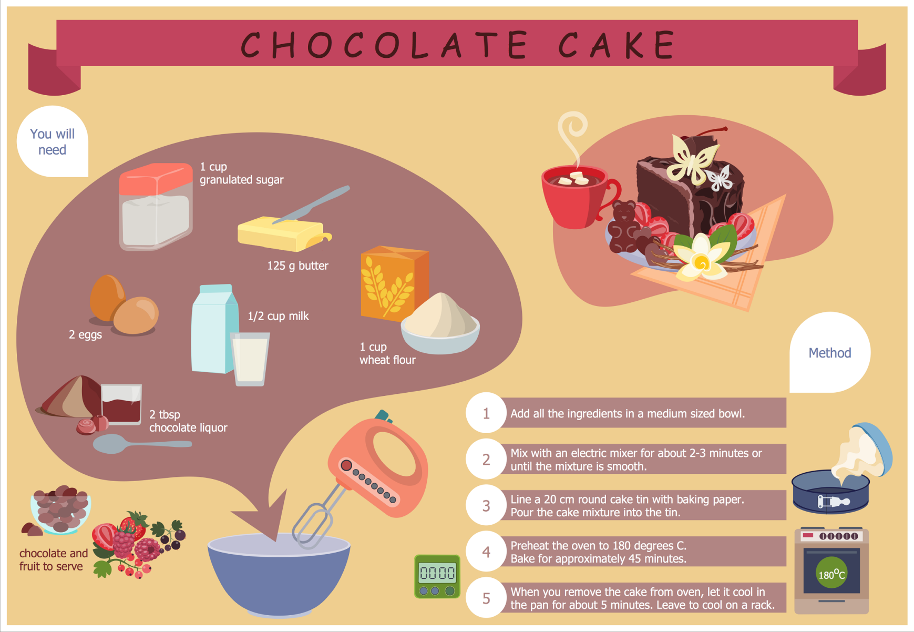
Solution Idea

Slide 6
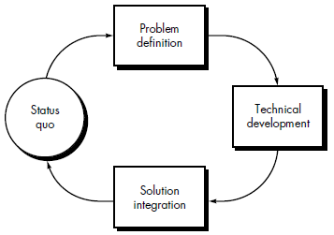
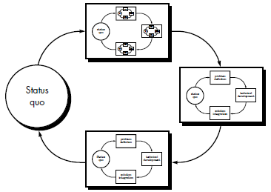
Process and Process Model [1, 3]
A process is a set of partially ordered steps intended to reach a goal.
A process model is an abstract description of an actual or proposed process that represents selected process elements that are considered important to the purpose of the model and can be enacted by a human or machine.
Software process is a partially ordered set of activities undertaken to manage, develop and maintain software systems.
A software process model is an abstract representation of the software process.

Slide 7
Process and Process Model [2]
Process is a set of transformations of input elements into products.
Process model is the description of a process expressed in a suitable process modeling language.
A descriptive model describes the history of how a particular software system was developed.
A prescriptive model prescribes how a new software system should be developed.

Slide 8
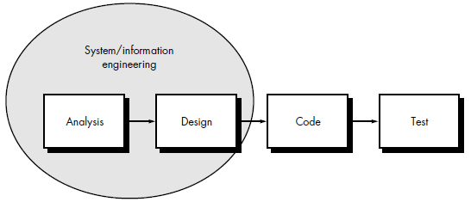
Software Process vs. SDLC
The life cycle centers on the product, defining the states through which the product passes from the start of construction (the initial state is the user need) until the software is in operation (this product state is the deployed system) and finally retired (the state is the retired system).
The software process centers on the construction process rather than on the product(s) outputted.
Software process can be used to develop more precise and formalized descriptions of software life cycle activities.
Software process power emerges from their utilization of a sufficiently rich notation, syntax, or semantics, often suitable for computational processing.

Slide 9
Elements of Process Model [2]
Activity is the stage of a process that produces externally visible changes of state in the software product.
Artifact or Product is the (sub)product and the “raw material” of a process.
Agent or Actor is an entity that executes a process.
Role describes a set of agent or group responsibilities, rights and skills required to perform a specific software process activity.

Slide 10
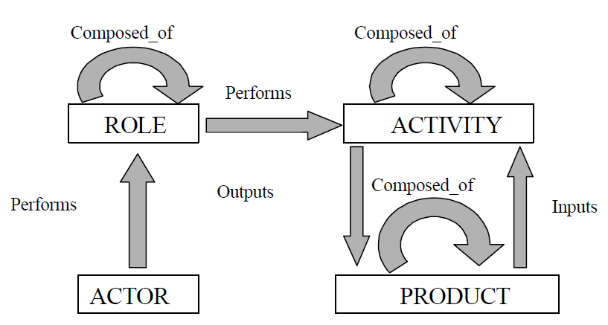
Relationships Among Elements

Slide 11
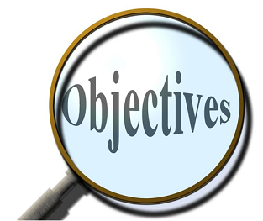
Software Process Objective
The software process has a common objective: to build and maintain a software product that satisfies a need detected by a user.
The integral software process model seeks to do just this: define a series of activities to be performed to produce software.

Slide 12
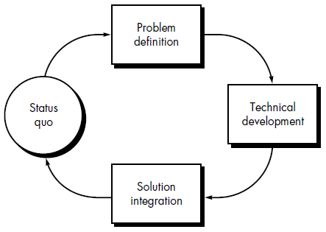
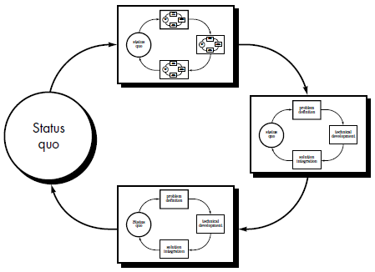
Problem Solving Loop [3]
Regardless of the process model that is chosen for a software project, all of the stages—status quo, problem definition, technical development, and solution integration—coexist simultaneously at some level of detail.

Slide 13
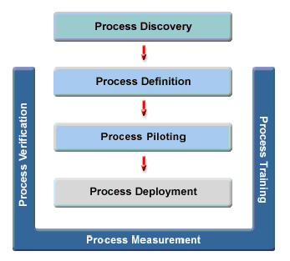
How to Use a Process?
Process
Training
Money
Skilled people
Proper tools
Management commitment
People are more important than any process.
Good people with a good process will outperform good people with no process every time.
– Grady Booch

Slide 14

Why Software Process?
Bringing discipline to various tasks in software development.
This discipline leads to consistency and uniformity in products delivered at the end of these tasks.
Project predictability (framework for software development plan)
Better communication and learning
Preventing wasted effort and repeated errors
Having good processes to follow vs. hiring only brilliant people
Having people work smarter vs. having people work harder
Guarantee for customers (schedule, budget and quality)

Slide 15


Slide 16
Process Model Information [1]
Functional: represents which process elements are being implemented and which information entity flows are important for the above process elements.
Behavioral: represents when (that is, sequentiality) and under which conditions the process elements are implemented.
Organizational: represents where and by whom in the organization the process elements are implemented.
Informative: represents the information entities output or manipulated by a process, including their structure and relationships.

Slide 17
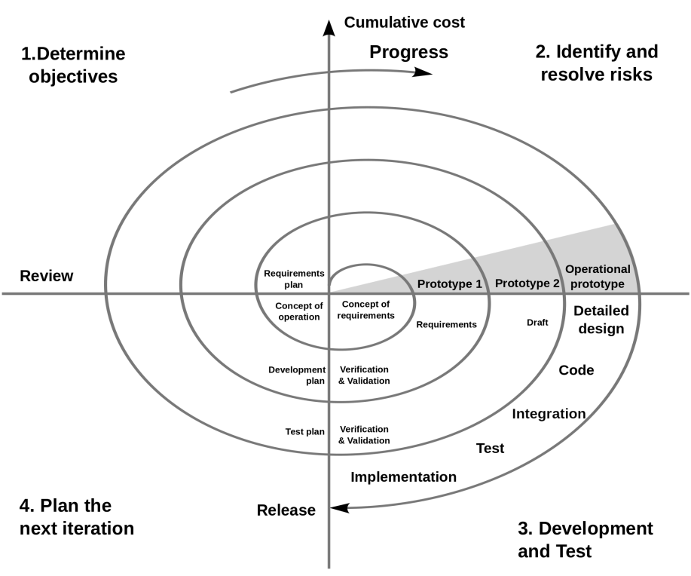
Effective Process Models
Represent the way the work is actually (or is to be) performed.
Provide a flexible and easily understandable, yet powerful, framework for representing and enhancing the process.
Be refinable to whatever level of detail is needed.

Slide 18
Software Process Modeling
Software process modeling describes the creation of software development process models.
Problems in traditional process description
– Ambiguous, unusable descriptions
– Failure to update the documentation with change
Needs from the enterprise
– Business process reengineering
– Coordination technology
– Process-driven software development

Slide 19
Process Modeling Goals and Benefits
Human understanding
Representation, training and communication
Process improvement
Comparison of alternative processes
Process management
Monitoring, management and co-coordination
Automated execution
Automated process parts, process integrity assurance
Automated guidance
Effective environment, user orientations, instructions and reference material

Slide 20
Process Modeling Paradigms
Programming models
Functional models
Plan-based models
Petri-net models
Quantitative models

Slide 21
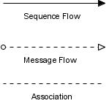



What is Business Process Modeling Notation?
Business Process Modeling Notation (BPMN) is a graphical representation for specifying business processes in a business process model.
Flow Objects: Events, Activities, Gateways
Connecting Objects: Sequence Flow, Message Flow, Association
Swimlanes: Pool, Lane
Artifacts: Data Object, Group, Annotation

Slide 22

Terminologies Clarification
Software process
Software process model
Software development life cycle
Software development life cycle model
Software development model
Software development method
Structured approaches to software development which include models, notations, rules, design advice and process guidance.
Software development framework
Method that leaves room for other practices and tools to be included.
Software development methodology
Method-OLOGY: study method, why method works, when method is appropriate.

Slide 23

Thank You & See You Again

